Slide 1
Strategies for 2021 sales.
Isaida Shiozawa
May 2021.

Slide 2
Table of contents.
Objective.
Previous years.
Zoom on 2020.
Conclusions.
Recommendations for 2021.
Appendix.
Profit on previous years.
Customer type on previous years.
Customers & profit.
Product type on previous years.
Products & profits.
Profits on 2020.
Customers on 2020.
Products on 2020.

Slide 3
Objective.
Analyze the behavior of the company's sales in recent years, to create guidelines that allow us to have good sales in 2021. Focusing on:
Profit of previous years.
Understanding customer types &
Product types.

Slide 4
Previous years.

Slide 5
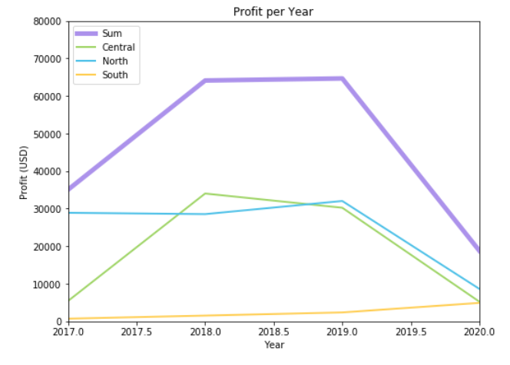
Profit on previous years.
COVID affected the sales on 2020.

Slide 6
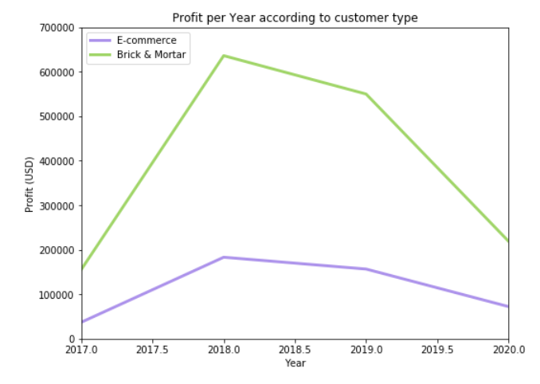
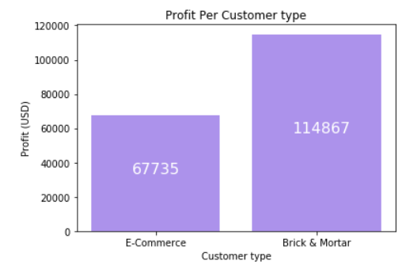
Customer type on previous years.
Brick & Mortar is the most important customer type.
E-commerce channel has a fairly stable trend over the years.
Although in 2020 there was a decrease in profits, E-commerce customer had a much smaller decrease than Brick & Mortar.

Slide 7
Customers & Profit.
Profit level | Amount of orders | Orders %
Positive | 49260 | 52.52
Zero | 1297 | 1.38
Negative | 43239 | 46.10
There were 38 customers with 93726 orders.
There is high data dispersion among orders, this could imply that there is not clear control over which customers generate profits.

Slide 8
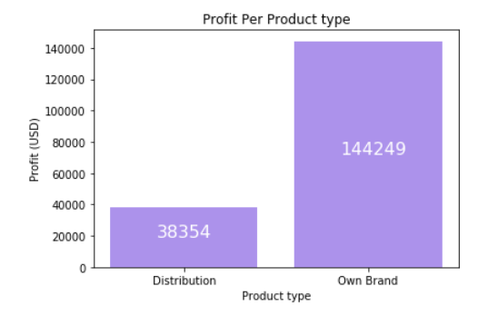
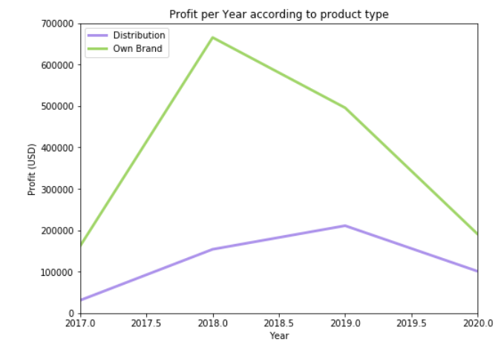
Product type on previous years.
Most of the profit comes from our Own Brand.
Although in 2020 there was a decrease in profits, Distribution products had a much smaller decrease than those from Own Brand.

Slide 9
Products & Profit.
Profit level. | Amount of Products. | Product %.
Positive. | 184 | 65,95
Negative. | 95 | 35,05
Almost a third of the products we are selling are generating losses.

Slide 10
Zoom on 2020.

Slide 11
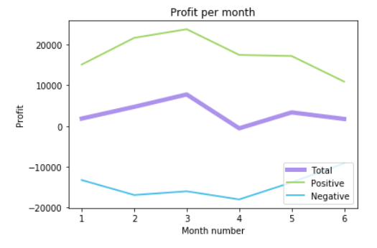
Profits on 2020.
We only have information of the first half of the year.
The losses began in April.
In 2020 there were 18785.63 USD in profits.
The top 5 customers created 63,29% of profit, these are:
Electricalsara Stores
Surge Stores
Excel Stores
Modular
Premium Stores

Slide 12
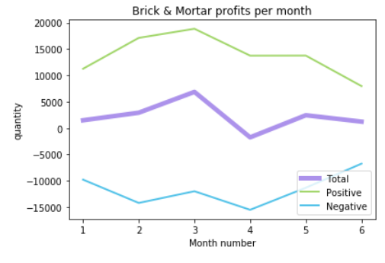
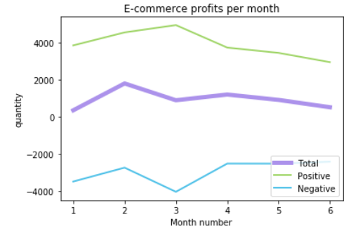
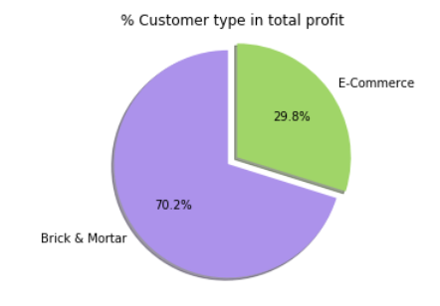
Customers on 2020.
Most of the profits came from Brick & Mortar.
In both cases the profit decreased
after March.
There were 38 customers on 2020.

Slide 13
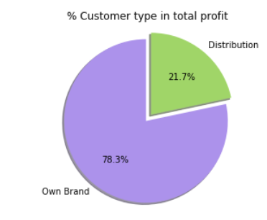
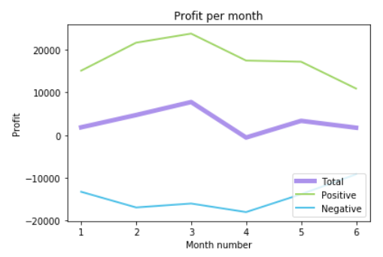
Products on 2020.
146 products were sold on 2020.
Most of the profits came from our Own Brand.
The profits started to decreased after March.

Slide 14
Conclusions.
The strategy of selling many products to the customers did not work in 2020.
Our products had a significant profit drop during 2020.
April was the month that most negatively impacted the 2020 profits.
There is high dispersion among products that generate profits and losses.
"Brick & Mortar" sales had a very negative impact on profits in 2020 however, the drop was less important in the e-commerce channel.
Customers seem to be differentiated by the level of profit. The ones that generated the most profits were: Electricalsara Stores, Surge Stores, Excel Stores, Modular & Premium Stores.

Slide 15
Recommendations for 2021.
The strategy should focus on improving the relationships with customers who generate most of the profits. Maintaining continuous contact with them could help us find which are the best products to sell.
The communication must be maintained through "Brick & Mortar “ & " E-commerce “ channels.
Once we understand which products are the most important, we should talk with the suppliers to create a joint strategy that help optimize the distribution of their products.

Slide 16
Appendix.
In case anyone need more details of the analyzes carried out, you can see the document attached to this link.

